Slide 1

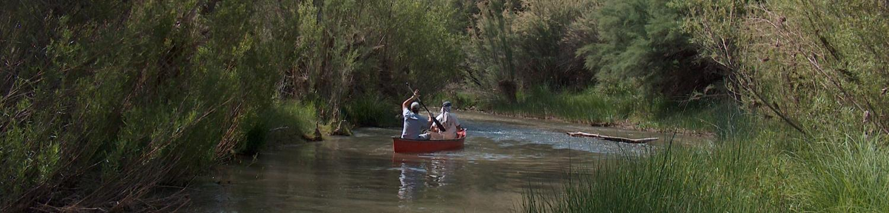
Rivers and People
Maintaining nature’s benefits
Environmental Flow Science, Opportunities and Barriers
Jeanmarie Haney jhaney@tnc.org

Slide 2
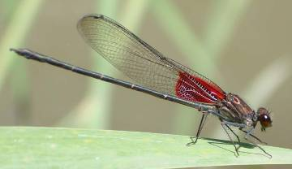
Summary
Situational analysis
Freshwater ecosystem services
How human’s have changed Arizona’s rivers
How The Nature Conservancy does its work
The natural flow paradigm
The science of environmental flows
Discussion
Damsel fly

Slide 3
Arizona’s Population in 2000
U.S Census
U.S Census
Notes:
Arizona grew rapidly in the 20th century. Since 1960, the population has doubled every 20 years. Our current population is 6.2 million. Over half of the population increase is due to internal migration, people from other parts of the US migrating to AZ (a quarter is caused by natural increase, a quarter by international migration).

Slide 4
Arizona’s Future Population
AZ
Dept. Economic Security
U.S Census
Notes:
Population growth projections vary widely, but an estimate approved by the AZ Department of Economic Security suggests that our population will double by 2050 to approximately 13 million people. Other projections that we found predict 9 to 16 million people by 2050.

Slide 5
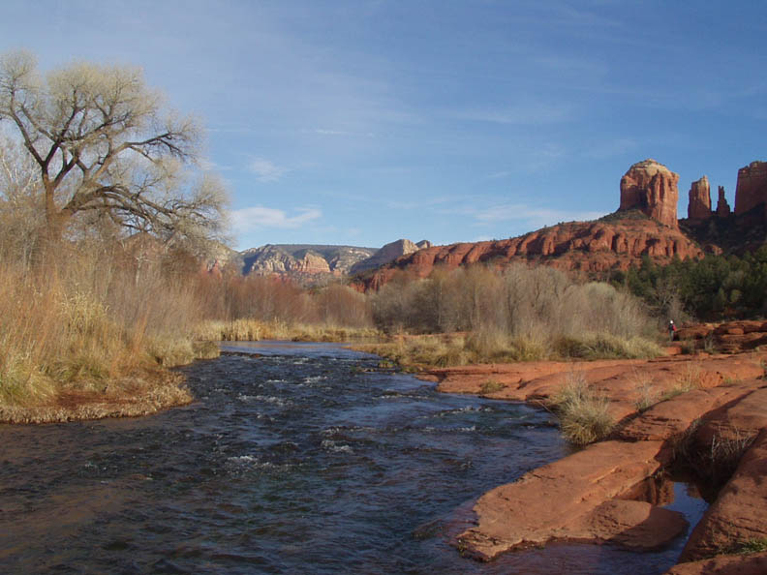
Red Rock Crossing with Cathedral Rock

Slide 6
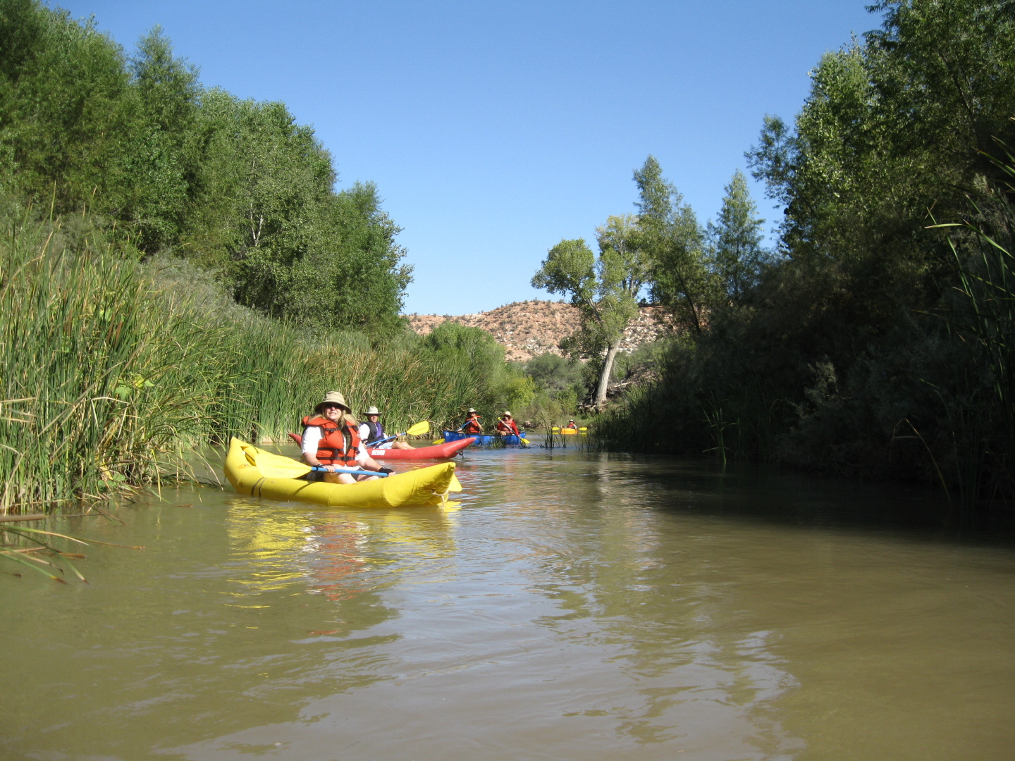
Kayaking the Verde River through Cottonwood

Slide 7
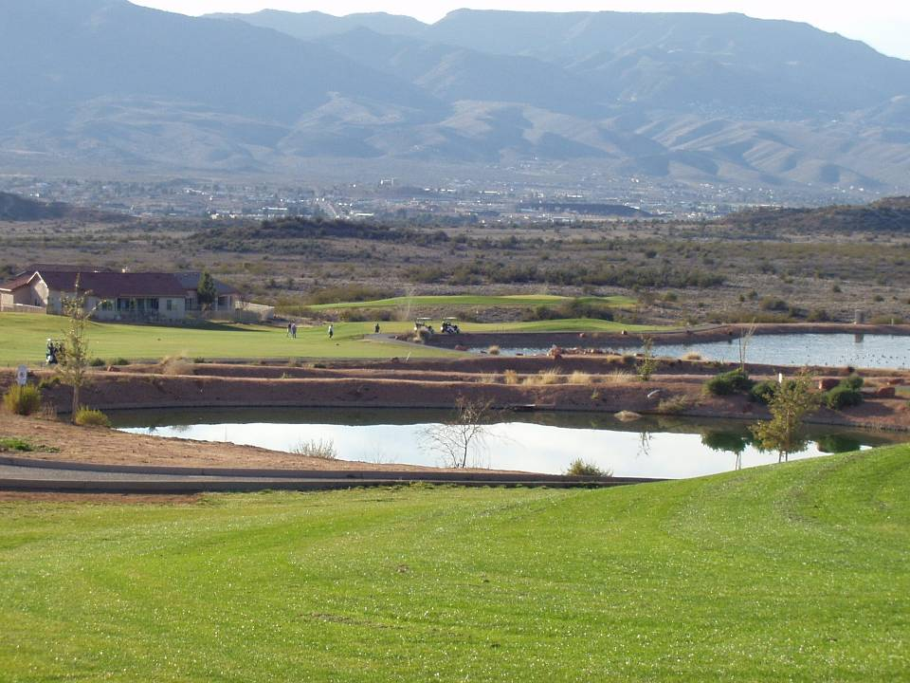
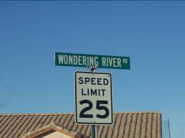
Golf course – Verde Santa Fe, Cottonwood
Notes:
Burgeoning and largely unmanaged population growth, combined with a water law that essentially does not recognize a physical connection between groundwater and surface water, all occurring in a severely water-limited arid landscape, pose threats to the continued survival of the Verde River, a situation that repeats itself on nearly all of Arizona’s remaining perennial rivers.
(C) an analysis of the potential long-term consequences
of various water use scenarios on groundwater levels and
Verde River flows.

Slide 8
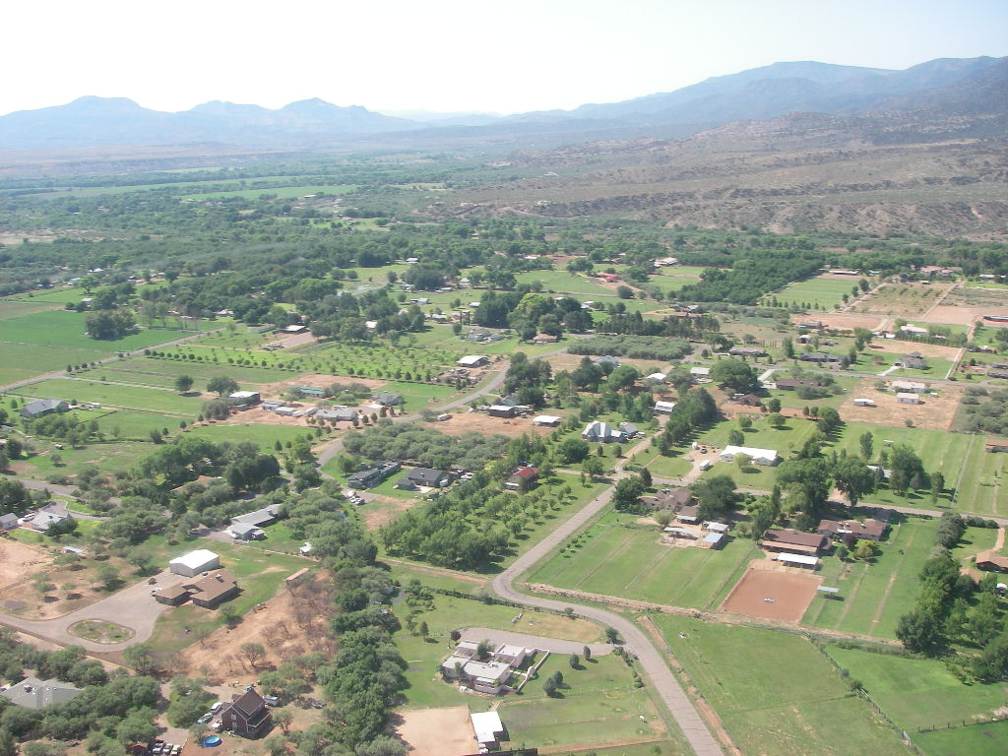
Orchards and pasture in Camp Verde

Slide 9
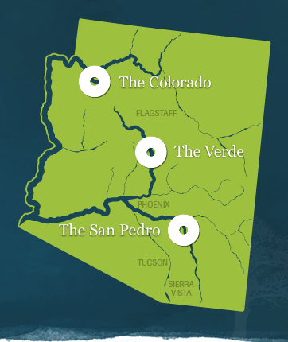
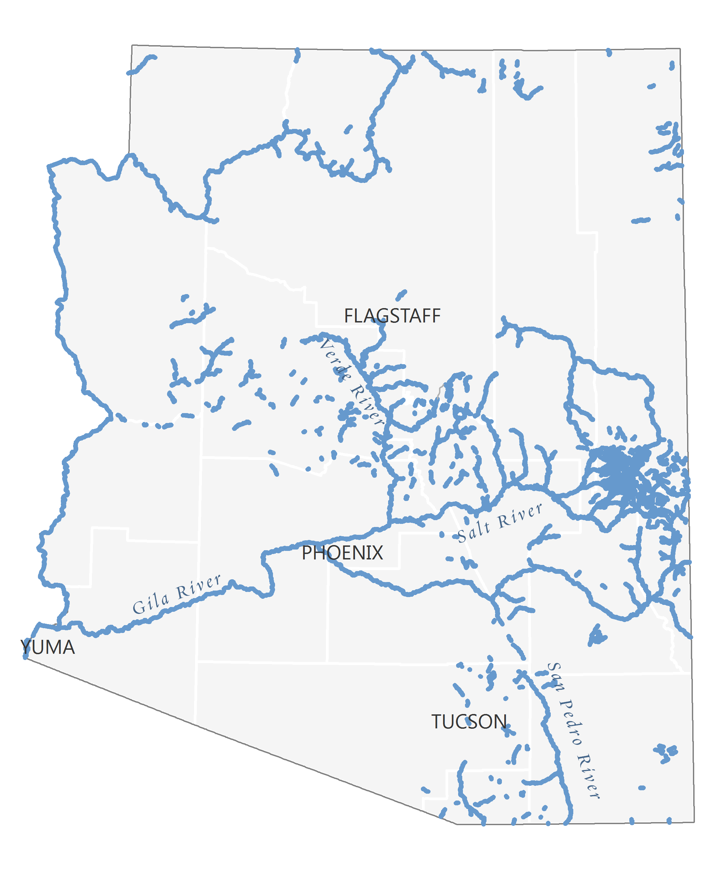
Choices for Our Changing Rivers
Past
Flowing Rivers

Slide 10
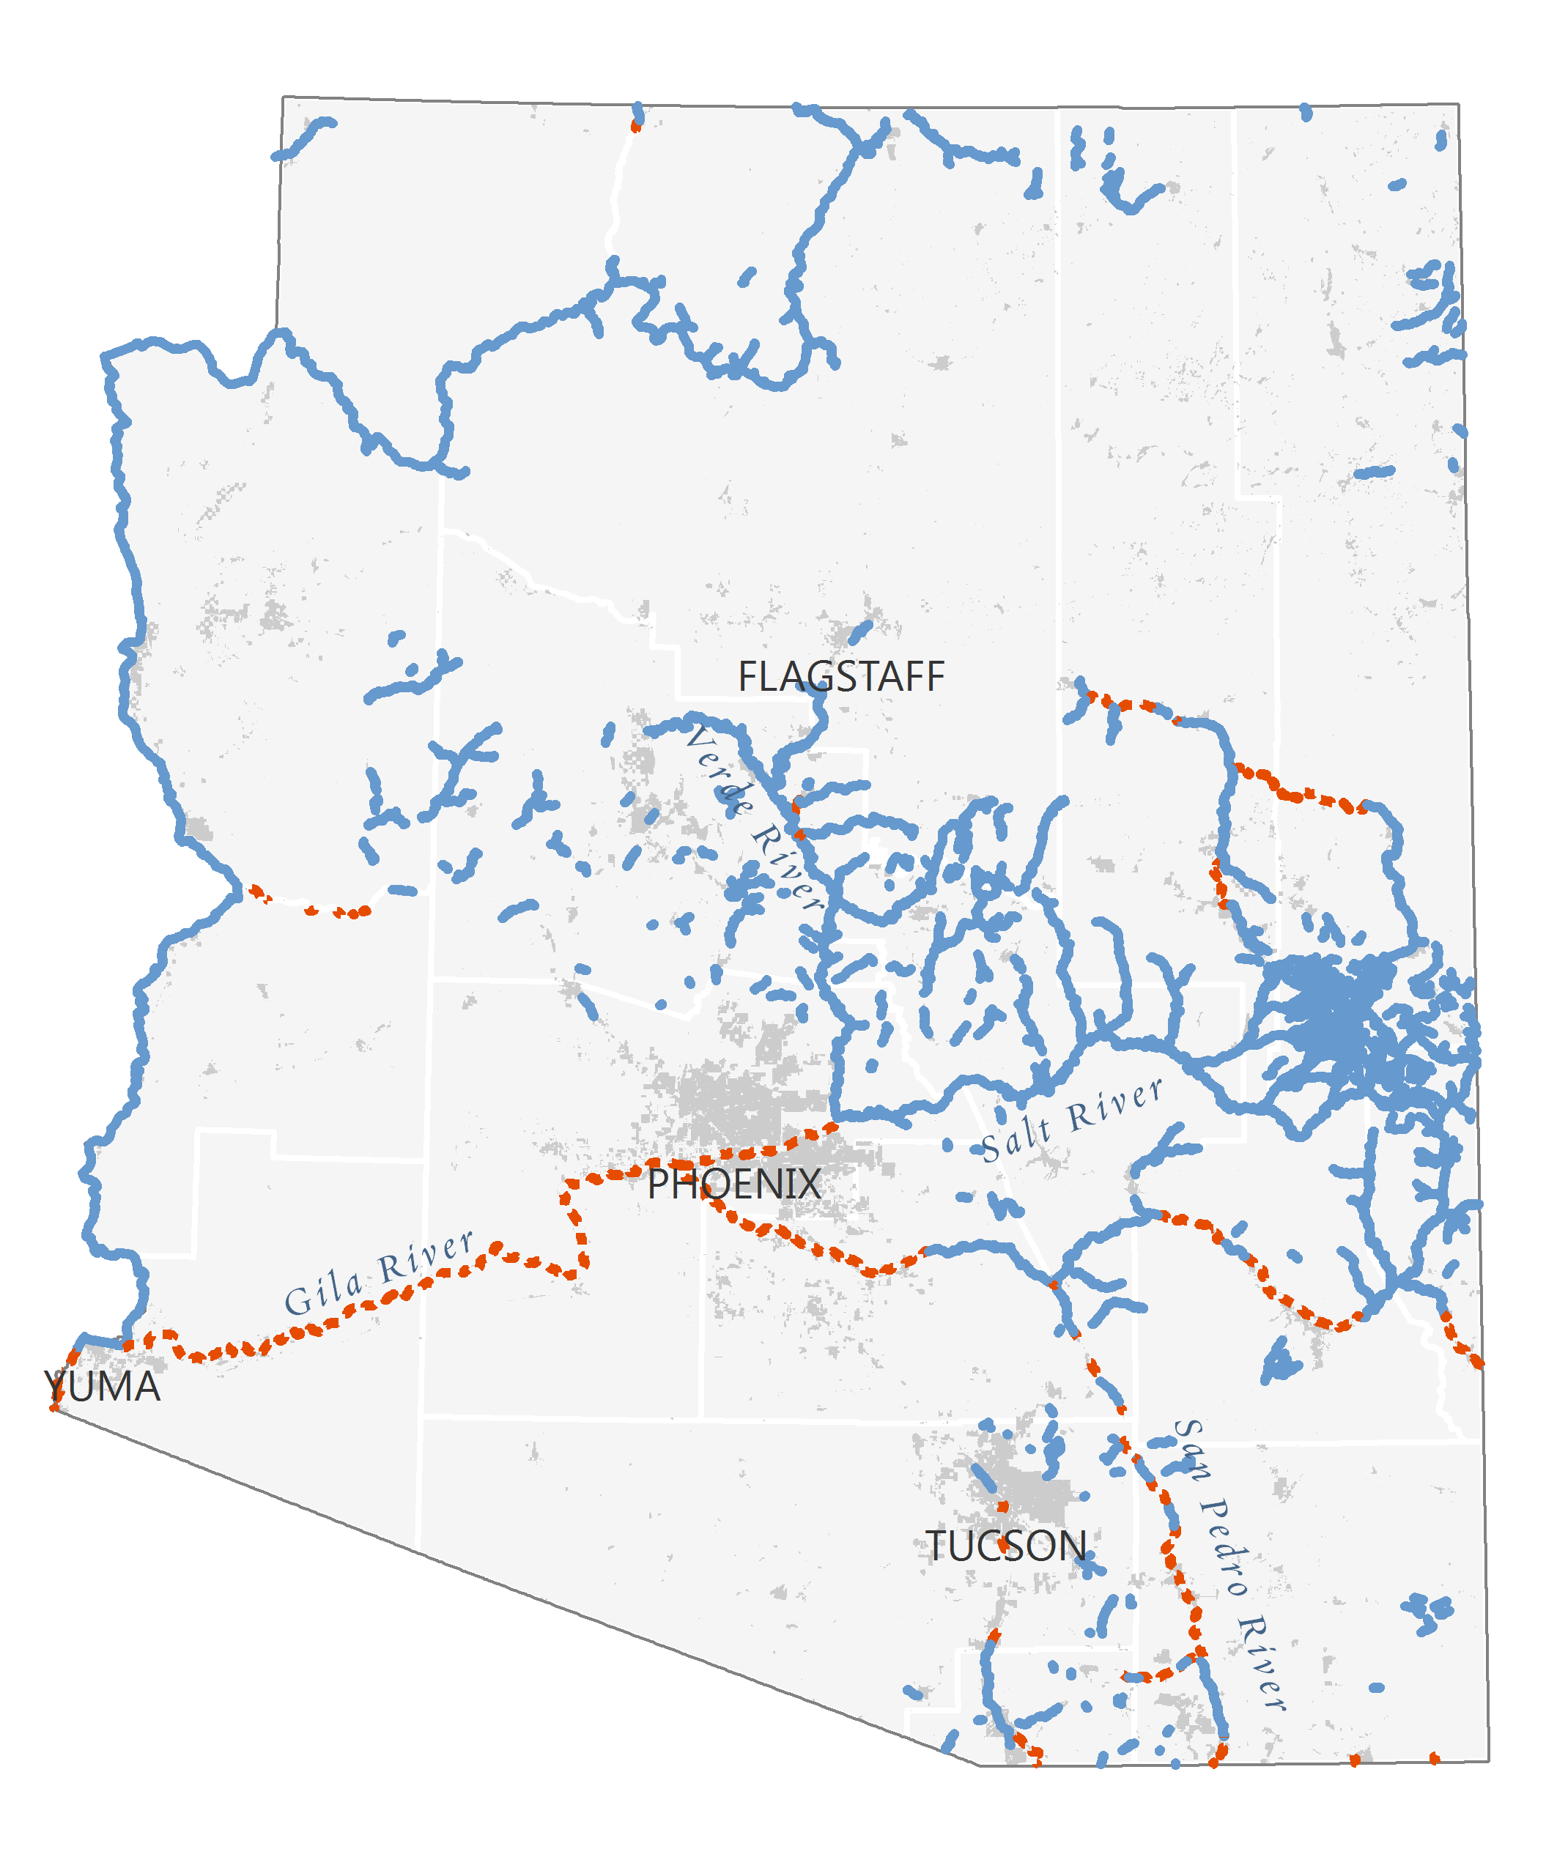
Choices for Our Changing Rivers
Present
Flowing Rivers
Lost Rivers
Human Footprint

Slide 11
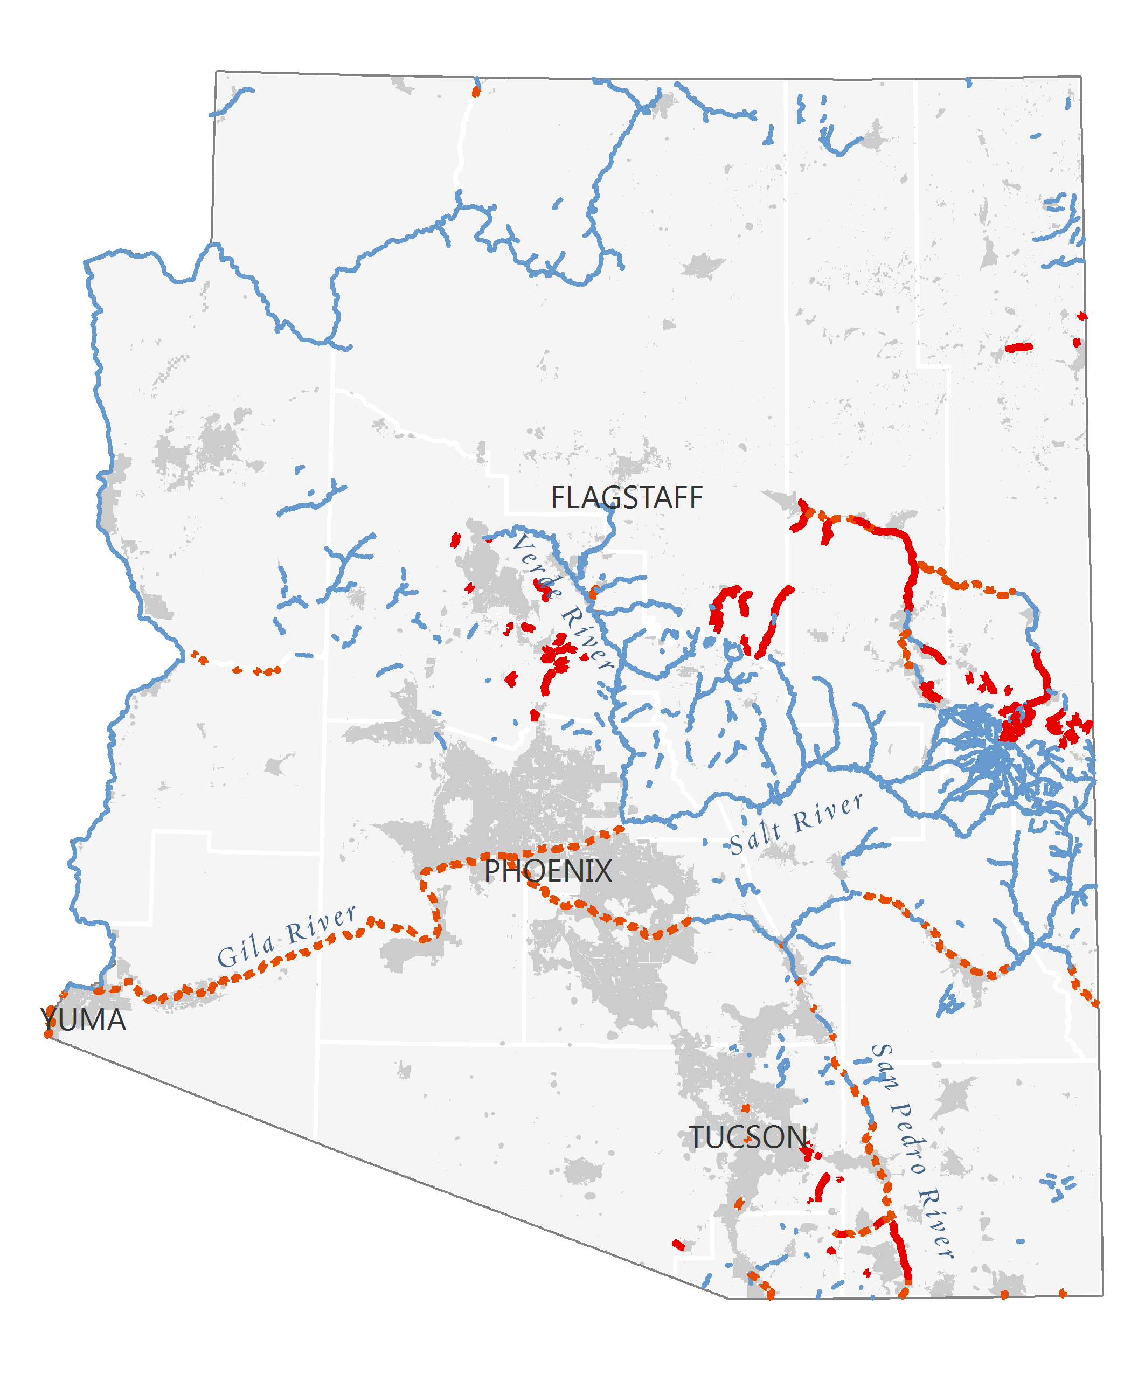
Choices for Our Changing Rivers
Future Choices
Flowing Rivers
Lost Rivers
Threatened Rivers
Human Footprint

Slide 12
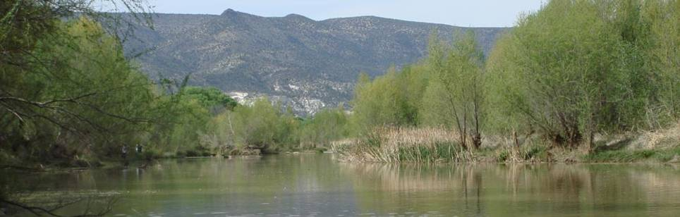
The mission of The Nature Conservancy is to conserve the lands and waters on which all life depends.
Notes:
The Nature Conservancy protects Earth's most important natural places — for you and future generations — through great science and smart partnerships.

Slide 13
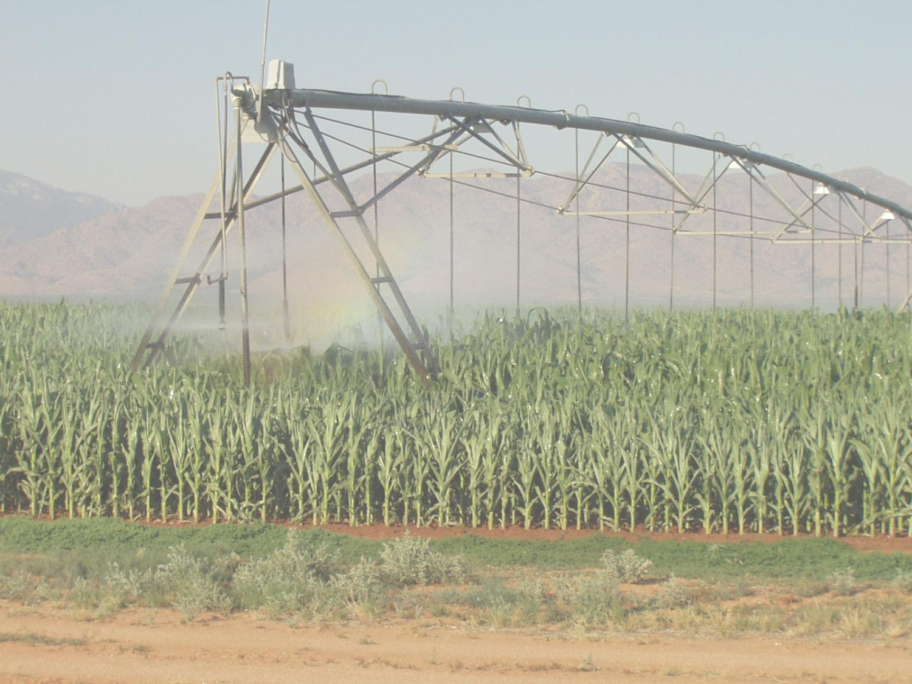
TNC’s Role
Promote water management that
considers human and
ecosystem water needs
San Pedro River basin, Cochise County
Notes:
by developing the scientific basis for sound decision-making relative to biological diversity and ecosystem services
Sutainable Water Management
Consider water needs of non-human water users
Consider consequences of probable future growth scenarios
Make wise choices to maintain quality of life and economic vitality

Slide 14
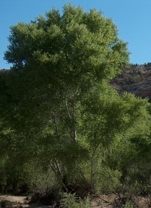
Science and Policy
Science
  Where water comes from
  Where it is going
  How much water do the rivers need
  Meeting human and ecosystem needs
Policy
  Understand community values
  Develop collaborative partnerships
  Support integrated water management
Cottonwood
Notes:
Work towards meeting human needs while minimizing negative consequencesto our rivers, creeks, and riparian habitat.

Slide 15
Ecosystem Water Needs
What are the spatial and temporal patterns of surface and sub-surface water needed to maintain the integrity and long-term viability of riparian and aquatic ecosystems?

Slide 16
Environmental Flows
The provision of water in sufficient quality, quantity, timing and duration to maintain freshwater ecosystems and their benefits.
The allocation of water to achieve a desired environmental condition.
Definition from World Conservation Unit
Notes:
Environmental flows is a concept that is gaining wide acceptance and application all over the world. An environmental flow is the water regime required by a river to maintain the ecosystem, and the services it delivers, where there are competing water uses.
environmental flows: the provision of water in sufficient quality, quantity, timing and duration to maintain freshwater ecosystems (and associated ground water systems) and their benefits. The allocation of water to achieve a desired environmental condition. (IUCN definition)
Add info from summary paper – no of sites, countries

Slide 17
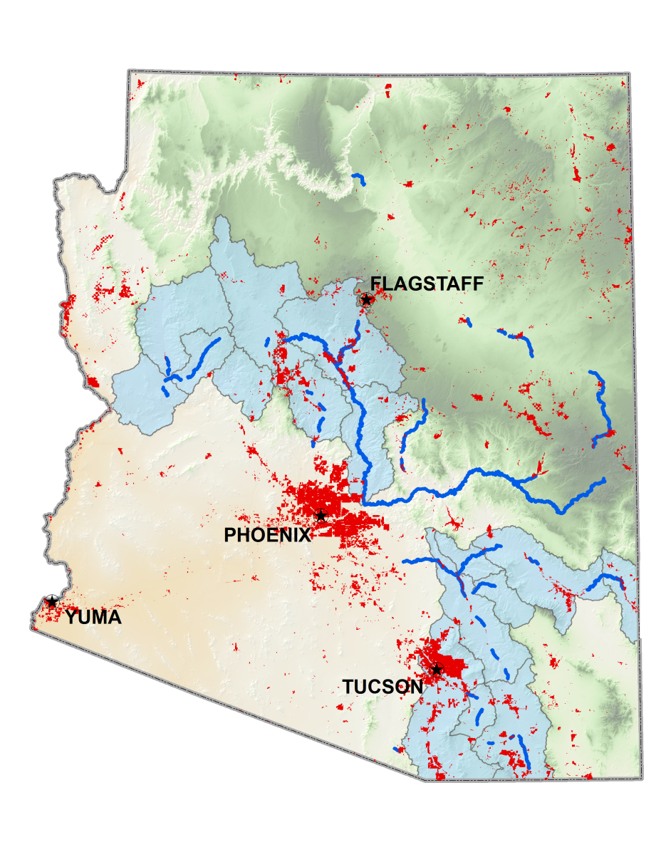
Rivers and Groundwater

Slide 18
Streamflow Regime
ENVIRONMENTAL FLOW COMPONENTS
Output from TNC’s IHA software
Large flood
High flow pulse
Small flood
Streamflow (cfs)
Low flow
Extreme low flow
Day of Year
Magnitude, frequency, duration, timing, rate of change
For each:
Notes:
COMPUTING FLOW STATISTICS AND HYDROLOGIC ALTERATION
Hundreds of flow statistics that are already being used in hydro-ecological research and environmental flow assessments may also be used in ELOHA. Among these are the 34 “Environmental Flow Components,” or EFCs, introduced by The Nature Conservancy to describe the magnitude, duration, frequency, timing, and rate of change of pulses, large and small floods, and low and extreme low flows. EFCs are well suited for ELOHA because they strongly link between environmental flow assessment and implementation, and they have clear ecological relevance. Because EFCs are intuitive to hydrologists, ecologists, and water managers alike, they greatly facilitate communication and understanding between the disciplines. The Nature Conservancy’s Indicators of Hydrologic Alteration (IHA) software (free download at nature.org/freshwaters) calculates hydrologic statistics, including EFCs, and also measures the degree of hydrologic alteration between baseline and developed conditions. ELOHA uses statistical methods to select a small, manageable subset of non-redundant flow variables for analysis of hydrologic alteration.

Slide 19
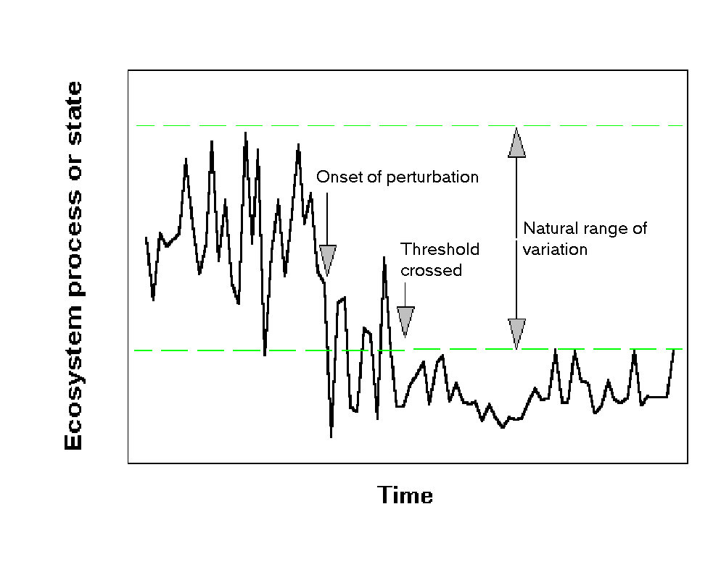
Natural Ranges of Variation
Minimum Integrity Thresholds

Slide 20
Tying Biologic Needs to Hydrologic Conditions
Notes:
The science goal of the study is to develop an ecological model of the Verde River that delineates flow-ecology relationships (including groundwater conditions).
In flow-ecology studies, key flow-biota relationships are first delineated conceptually, based on published literature and expert opinion. As additional data become available through focused research, statistical analyses of relationships between hydrology, hydraulics, and ecology provide the input for coupled hydro-ecologic modeling. GIS technology can be used to display results and other relevant spatial data.

Slide 21
The Verde River – three USGS gages
Notes:
Note that Camp Verde gage, below the diversions in the Verde Valley, shows strong drawdown of base flows during the summer months. This is an illustration of flow alteration due to upstream irrigation diversions.

Slide 23
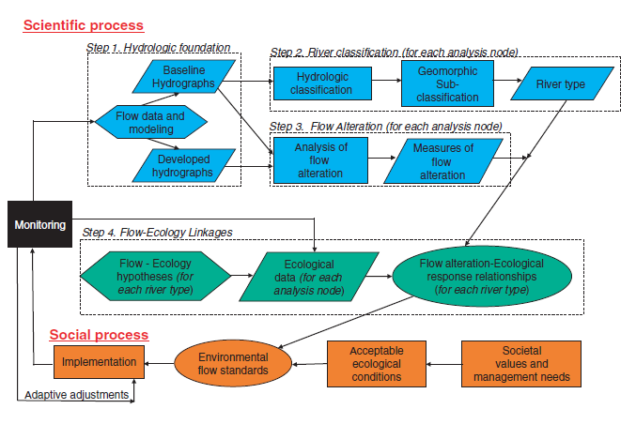
How do we DO it?
2003: Global review found 207 methodologies applied in 44 countries in six world regions.
Tharme, R.E. 2003. A global perspective on environmental flow assessment: River Res. Applic. 19: 397–441
2009
Poff, et al 2009. The ecological limits of hydrologic alteration (ELOHA): a new framework for developing regional environmental flow standards. Freshwater Biology: 1365-2427
Notes:
These could be differentiated into hydrologic, hydraulic rating, habitat simulation and holistic methodologies, with a further two categories representing combination-type and other approaches.
Poff: 19 authors from US, UK, and S. Africa research institutions; USFS; USGS; TNC.

Slide 24
Generic Freshwater Integrity Diagram
Climate
Precipitation Temperature Regime
Precipitation Chemistry Regime
Precipitation Event Regime
Freeze/Thaw Regime
Non-Native Species!
Hydrology
Water Flow Regime
Water Elevation Regime
Water Circulation Regime
Surface/Groundwater Exchange Regime
Ice Transport Regime
Energy Inputs
Solar Radiation Influx Regime
Geothermal Energy Regime
key ecological factors of
Biological Composition and
Structure,
& Biotic Interactions
Sediment & Geomorphology
Bed Sediment Porosity-Texture Regime
Bed/Bank Sediment Chemistry Regime
Bed Sediment Erosion-Deposition Regime
Coarse Organic Matter Accumulation Regime
Water Chemistry
All Water Chemistry Regimes
Water Temperature Regime
Water-Borne Organic Matter Regime
Water Turbidity/Clarity Regime
Connectivity
Drainage Channel Connectivity Regime
Flood Inundation-Recession Connectivity Regime
Notes:
Freshwater integrity diagrams can also be more complicated, showing specific factors and their inter-relationships.

Slide 25
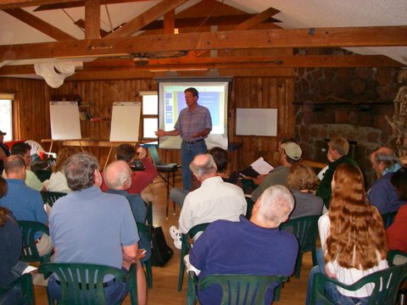
Verde River Ecological Flows Workshop
Experts created conceptual models of hydrology-biology relationships

Slide 26
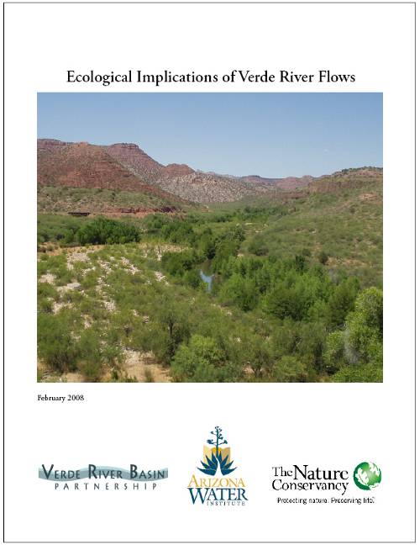
Authors
Jeanmarie Haney
  The Nature Conservancy
Dale Turner
  The Nature Conservancy
Abe Springer
  NAU, PI
Julie Stromberg
  ASU
Larry Stevens
  Museum of N. Arizona
Phil Pearthree
  Arizona Geological Survey
Vashti Supplee
  Audubon Arizona
www.azconservation.org
Notes:
Chapters:
1. Introduction
2. Hydrology of the upper and middle Verde River
3. Fluvial geomorphology and flood history of the Verde River
4. Stream flow regimes and riparian vegetation of the Verde River
5. Wildlife and flow relationships
6. Steps toward understanding ecological response to hydrologic variation
7. Synthesis: Verde River flows and ecosystem water needs

Slide 27
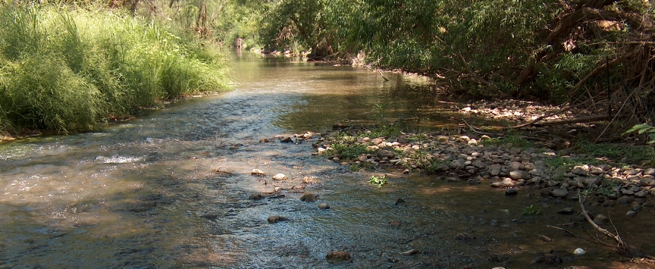
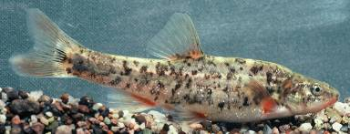
speckled dace

Slide 28
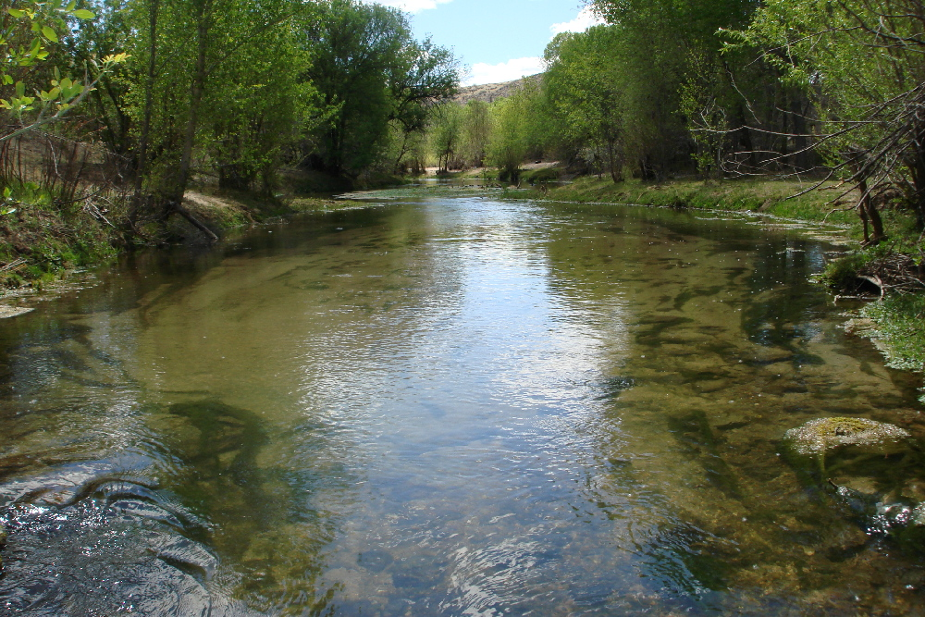
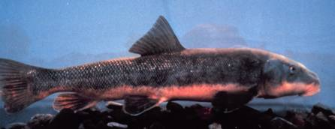
Sonora sucker

Slide 29
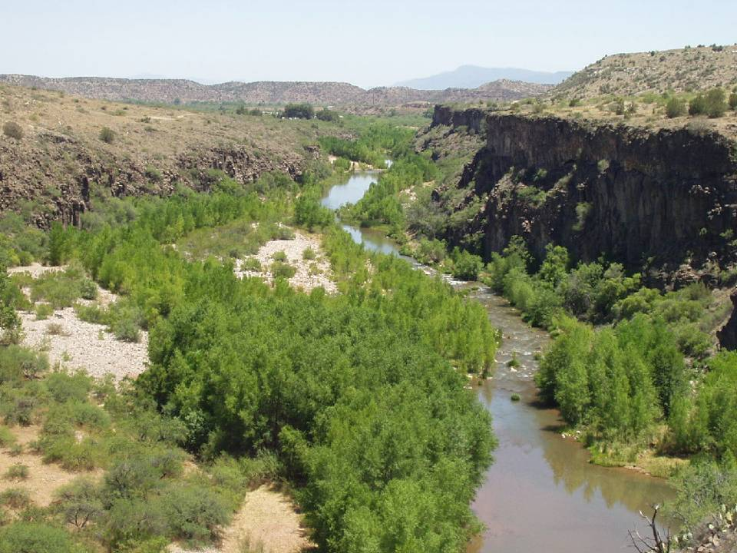
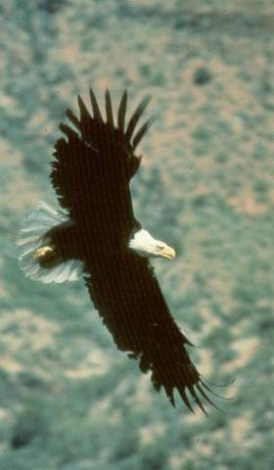
Bald Eagle

Slide 30
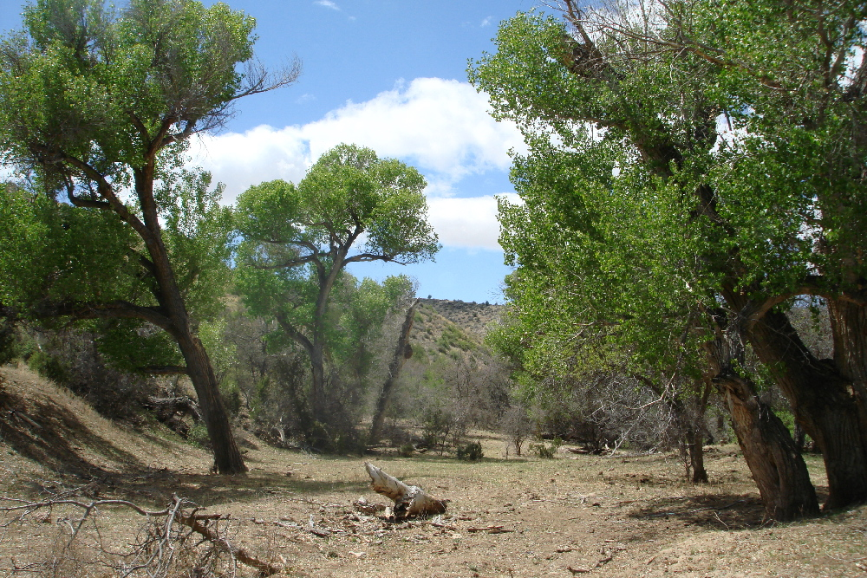
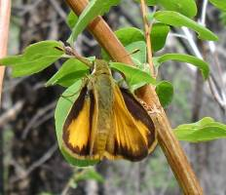
Skipper butterfly

Slide 31
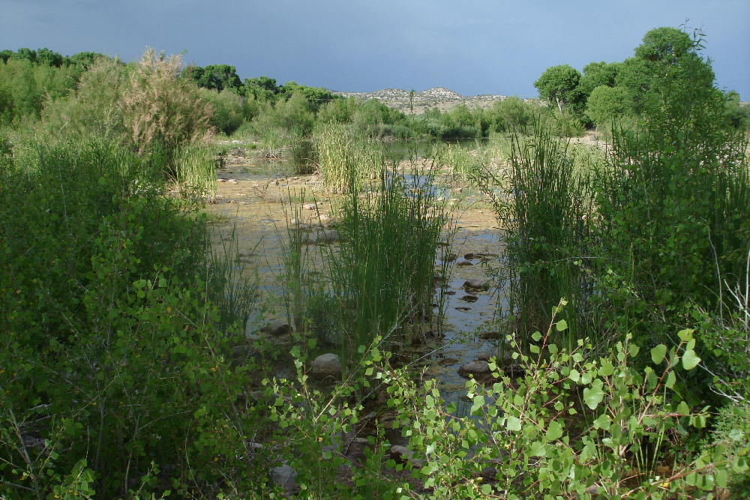
Ruby spot damsel fly

Slide 32
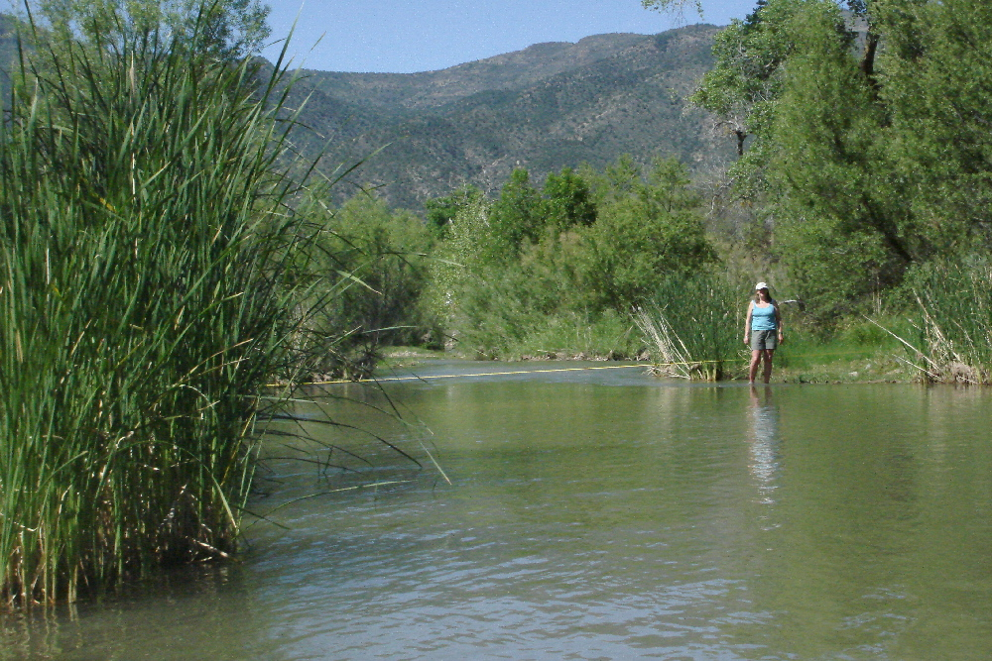
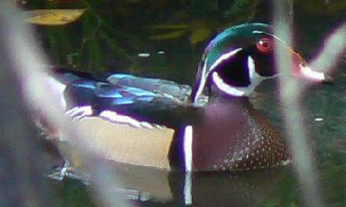
Wood duck

Slide 33
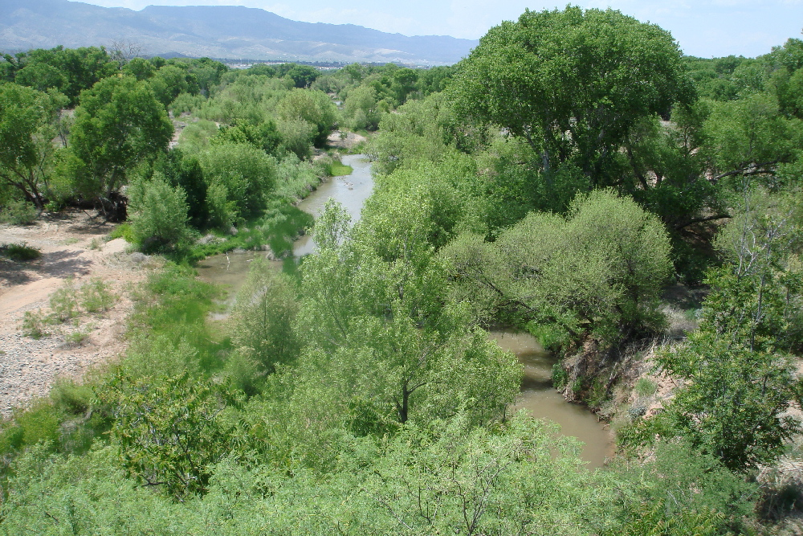
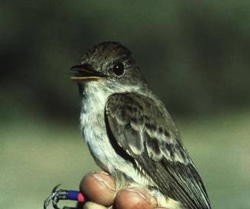
Southwestern Willow Flycatcher

Slide 34
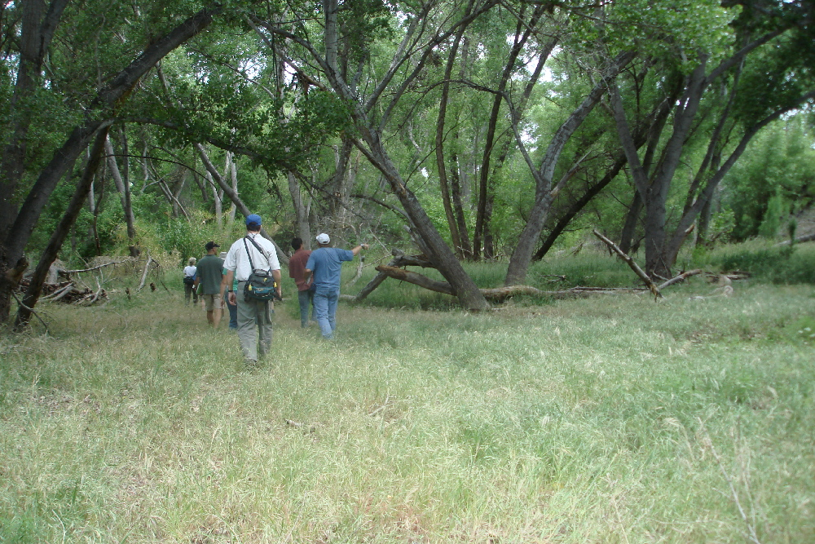
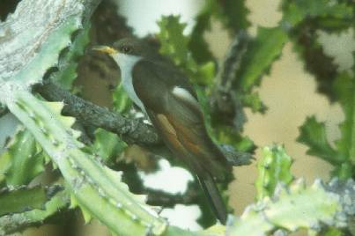
Yellow-billed Cuckoo

Slide 35
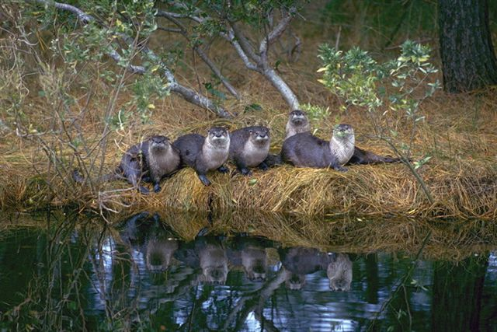
©Jack Mills

Slide 36
Critical Thresholds
Ecological processes and states have “natural ranges of variation”
Critical thresholds can be defined from an understanding of the natural ranges of variation
If a key ecological factor exceeds these limits, target will lose its integrity
You can not restore target integrity so long as an altered factor remains outside a critical threshold

Slide 37
Flow-ecology response curves for native fish and garter snake
Notes:
This curve shows the response of native fish to a reduction in base flow. Native fish response is represented by a change in population size of key species. As described in the scientific literature, some native fish species show a strong preference for specific habitats - such as riffles versus pools - for various life stages. Population size for riffle specialists would be expected to decrease first with decreased baseflow, as riffles would be the first to be habitat dewatered. (see speckled dace on the diagram) Pool dwellers, such as chub and sucker, would persist longer with reduction in base flow. In order to quantify the effects of a reduction in base flow, thus putting values on this graph, additional information is needed relating stage-discharge to extent of riffle and other macro-habitat.

Slide 38
Flow-ecology response curves for cottonwood (seedlings and mature trees), tamarisk, and mesquite
Notes:
A key flow-ecology relationship is between the health of cottonwood, mesquite, and tamarisk and the depth to groundwater. Cottonwood trees (and willows) are obligate phreatophytes, relying on groundwater as their primary water source.
The differing depth to water tolerances exhibited by cottonwood-willow, mesquite, and tamarisk leads to dominance of one species over another across the floodplain according to the height of different geomorphic surfaces above the groundwater. Similar replacement can take place over time at a given site with a rising or falling water table.
Data from the San Pedro River show a shifting pattern of dominance from cottonwood-willow to tamarisk along reduced water-availability gradients. The hydrologic variables most closely correlated with increasing tamarisk were stream flow permanence, depth to groundwater, and annual groundwater level fluctuation.
Overall, forests of cottonwood and willow were dense and multi-aged among sites where annual maximum groundwater depths averaged less than about 3 m, where stream flow permanence was greater than about 60 percent, and intra-annual groundwater fluctuation was less than about 1 m.

Slide 39
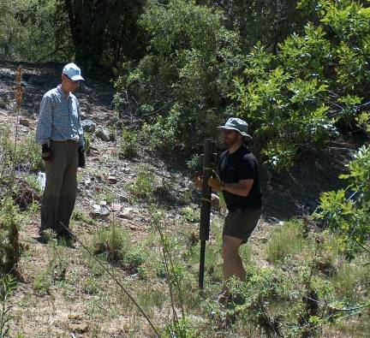
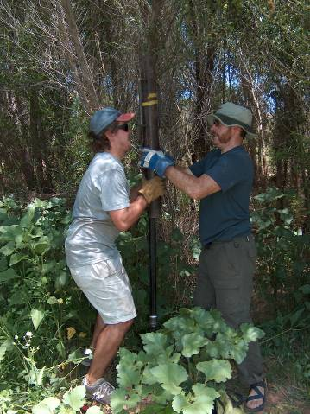
Well Point Installation
Campbell Ranch
Middle Verde

Slide 40
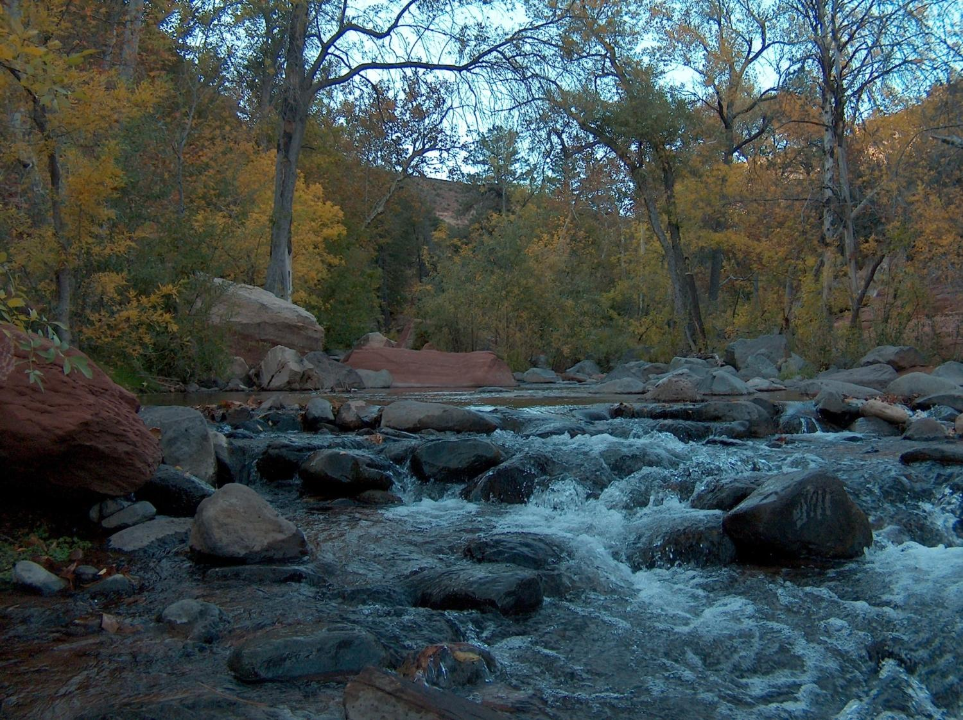

Slide 41
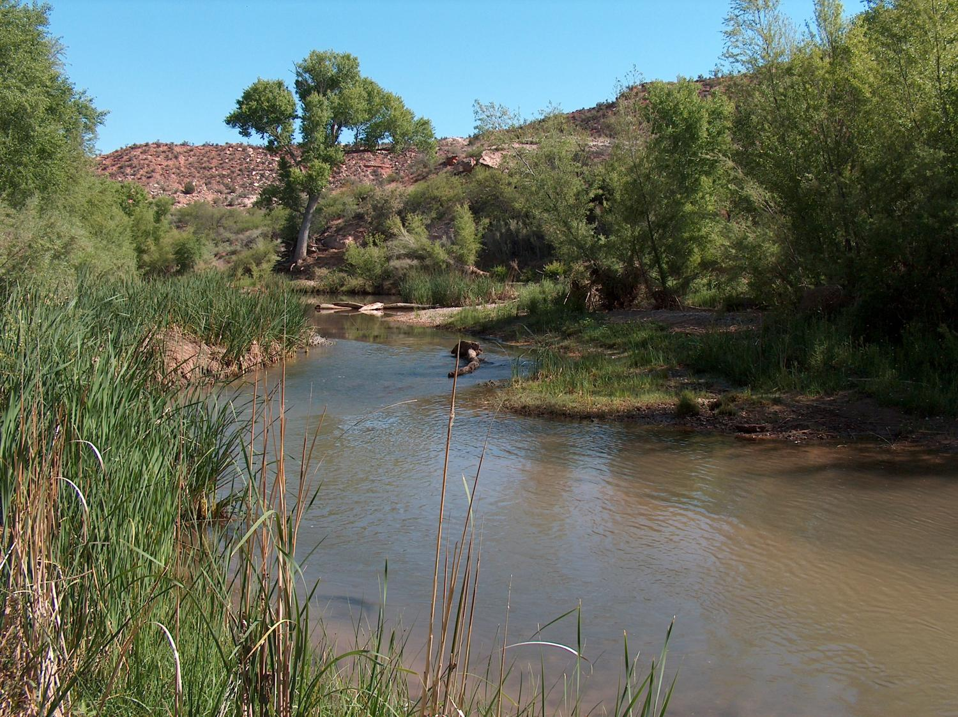
Notes:
Strategic
Priorities set through detailed planning
Science-based
Best available methods and data
Collaborative
Effective partnerships
Measuring success
Tangible, lasting results

Slide 42
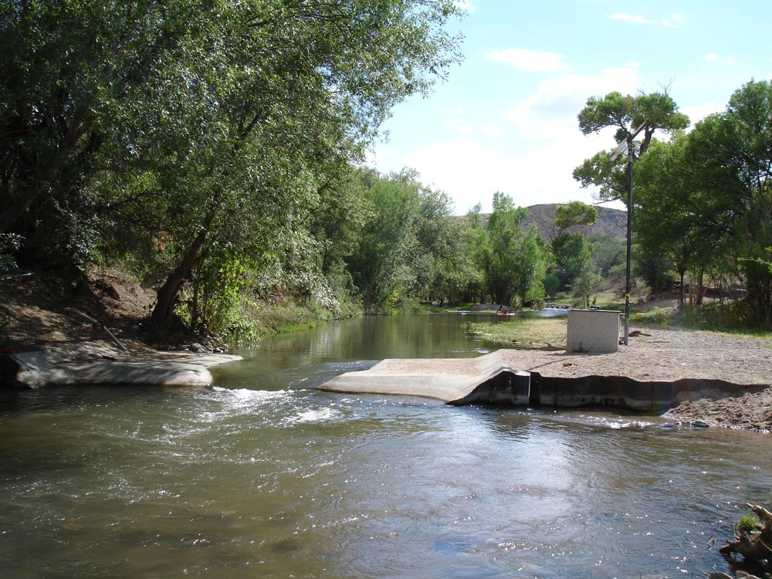

Slide 43
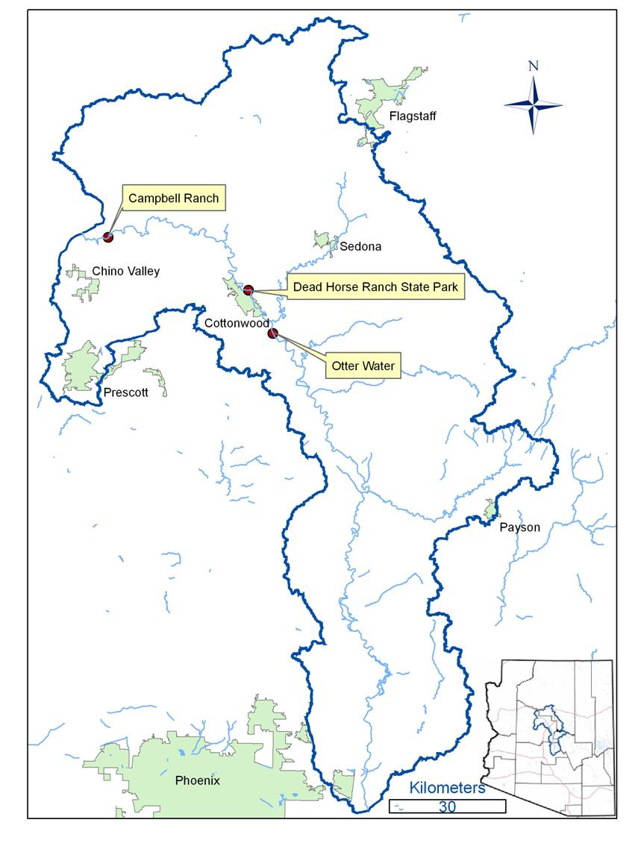
Phase II
Three Study Sites
riparian vegetation
fish
aquatic insects
West Clear Creek

Slide 44
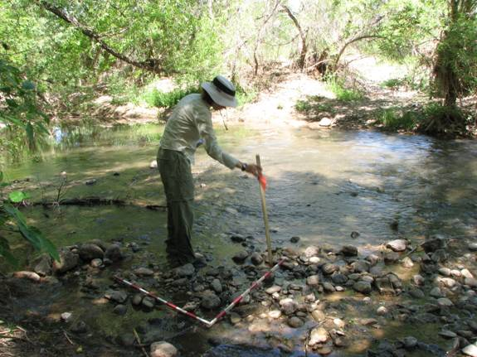
Phase II
Vegetation measured in plots (stream edge to terrace)
For each plot:
  depth to water table interpolated
  flood frequency estimated
Notes:
Otter water transect 1; groundwater from dec 08-oct 09

Slide 45
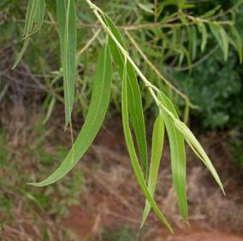
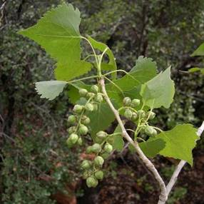
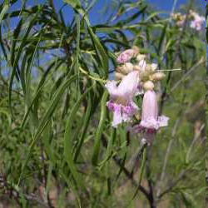
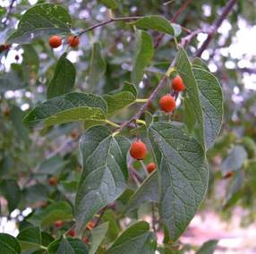
Phase II
Depth-to-water for riparian trees and shrubs
varies among species and functional types
Hydric pioneers
e.g. cottonwood, willow
Mesic
pioneer
Xeric
pioneer
e.g. tamarisk, boxelder, ash, ailanthus
e.g. mesquite, walnut, hackberry
Goodding’s willow Fremont cottonwood Desert willow Netleaf hackberry
Salix gooddingii Populus fremontii Chilopsis linearis Celtis laevigata var. reticulata
Notes:
45
This subset of hydroriparian species (which includes the willows and cottonwoods) are obligate phreatophytes that rely on shallow groundwater as their primary water source.

Slide 46
Phase II
Streamside herbaceous species
Threshold response
Linear response

Slide 47
Phase II
Aquatic Macroinvertebrates
Velocity consistently positively related to macroinvertebrate variables
Density/m² or
Species Richness
Velocity (m/s)
Notes:
Velocity was the single physical variable that was most consistently positively related to macroinvertebrate variables, with strongly positive interactions with density, species richness, and Shannon-Weiner H’ diversity (Fig.

Slide 48

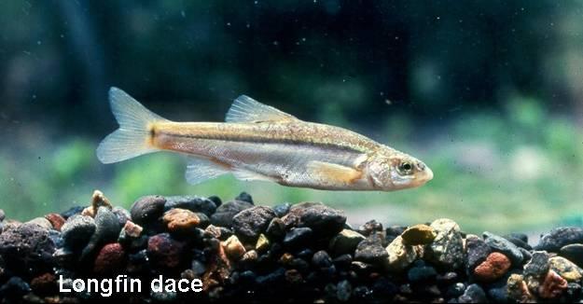
Hydrology- fish relationships
  13 native + 30 nonnative fish species in watershed
©Jeanmarie Haney/TNC
Notes:
48
Highest fish diversity in AZ

Slide 49
Conclusions: Verde River flows and biodiversity
Vegetation | Water table decline- thresholds of mortality of cottonwood, willow, shifts to shrubbier species
 | Base flow decline – thresholds of mortality of bulrush, other streamside wetland plants
 | Increased stream intermittency- species richness and total cover show linear response
Birds | Decline of obligate riparian birds as forests decrease in structural complexity
Aquatic invertebrates | Velocity positively correlated to density, species richness and diversity.
Fish | Habitat-flow associations, native/non-native competition

Slide 50
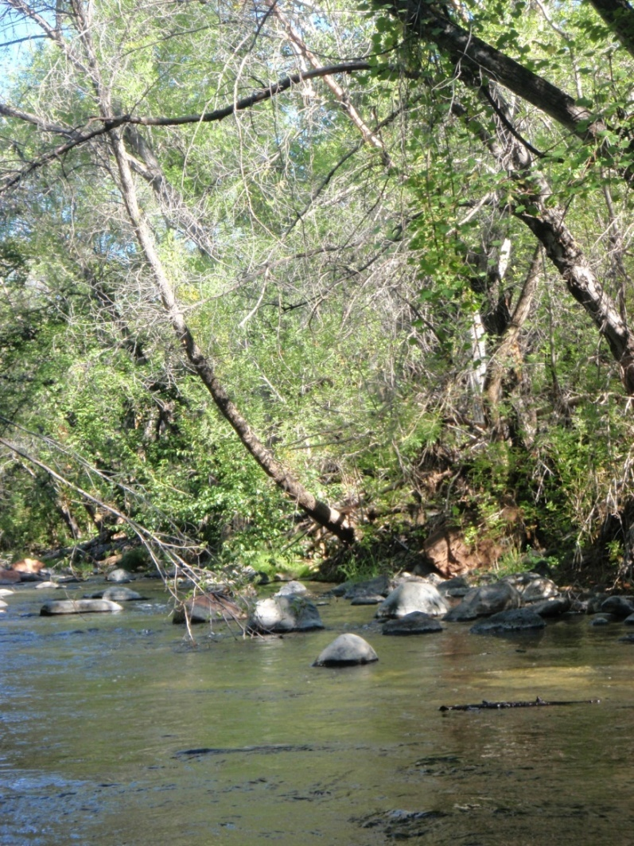


Determining flow-ecology associations
Phase III - USGS
Habitat models
Multivariate analyses
Hydrological and biologic metrics
Hydraulic models
How does stream flow affect habitat availability?
Notes:
Develop models that predict how changes in flow affect the animals and plants associated with the river
This information will provide a scientific foundation for decisions by managers

Slide 51
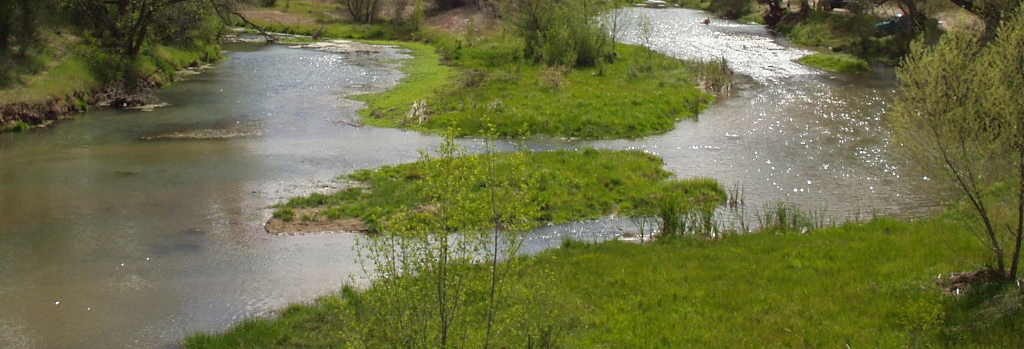
U.S. Examples
Texas “Environmental flow standards”
Connecticut “Flow regulation for all rivers and stream systems”
Florida “Minimum flows and levels”
Michigan “Withdrawals from new large capacity wells cannot decrease flows such that stream functionally would be impaired.”
Notes:
TEXAS: “Environmental flow standards”… “seasonal and yearly fluctuations”….“to maintain the productivity, extent, and persistence of key aquatic habitats”
CONNECTICUT: “Flow regulation for all rivers and stream systems”…“preserve and protect the natural aquatic life”…“based, to the maximum extent practicable, on natural variation of flows and water levels”
FLORIDA: adopted by the District to prevent significant harm to the water resources or ecology of an area resulting from water withdrawals permitted by the District
Michigan: Withdrawals from new large capacity wells cannot decrease flows such that stream functionally would be impaired. Based mostly on maintaining characteristic fish populations. Existing water uses were exempted from the law and current ecological conditions is set as the baseline. The median streamflow for the summer month of lowest flow was specified by state decision makers as the index flow on which likely impacts of withdrawals would be assessed.
Use of the WWAT is required of anyone proposing to make a new or increased large quantity withdrawal (over 70 gallons per minute) from the waters of the state, including all groundwater and surface water sources, prior to beginning the withdrawal. You must use the WWAT to determine if a proposed withdrawal is likely to cause an Adverse Resource Impact, and to register the withdrawal. Science was used as the basis for policy development with the intent of protecting environmental flows.

Slide 52
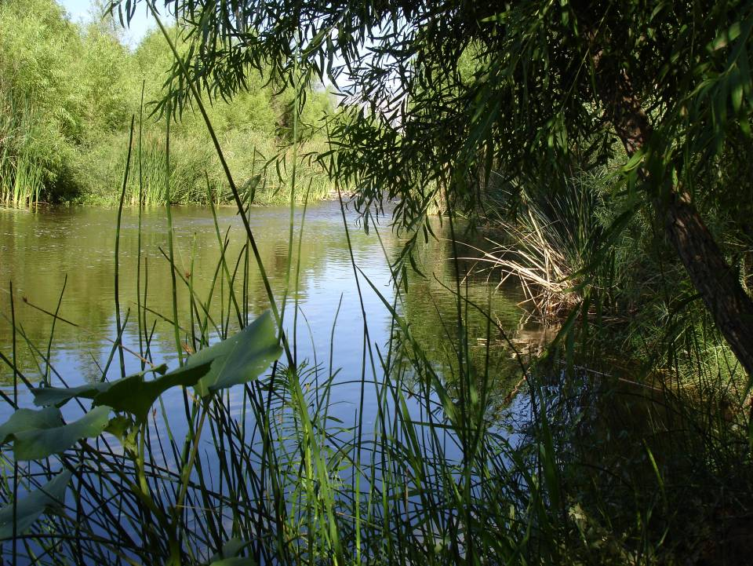
The best way to predict the future is to invent it.
Alan Kay
Verde River – Dead Horse Point State Park
Notes:
The Verde River is a vibrant and critical component of life in central Arizona and beyond, for both the natural and human communities. There is a great deal of concern regarding how the growing human water needs of the area are going to be met while also preserving the important ecological values of the Verde River.
Ecologically sustainable water management, with collaboration of involved parties and application of sound science as its corner stones, seeks to delineate the environmental flow needs for a river, understanding the consequences and trade offs of different river and groundwater management scenarios and providing management solutions for meeting both human and ecosystem water needs.

Slide 53

Jeanmarie Haney
jhaney@tnc.org
nature.org
azconservation.org
Verde River – Beasley Flat

Slide 54
Example Freshwater Conservation Targets
Gila River riverine habitat
Gila Basin fish community: Gila chub, spikedace, loach minnow, desert pupfish, Gila topminnow, longfin dace, desert sucker, Sonoran sucker
Fremont cottonwood / Goodding willow forest
Mesquite bosque
Giant sacaton grassland
Riverine marsh
Riparian scrub
Groundwater fed cienegas

Slide 55
A Framework for
Assessing Target Integrity
Identify the “Key Ecological Factors”
for each conservation target
Identify one or more “Indicators”
for each factor
Identify critical conservation “Thresholds” and “Management Goals” for these indicators
“Rate” target integrity using the indicators to assess target status

Slide 56
Key Ecological Factors
Those critical features of the target and its environment that we must maintain, in order to ensure its long-term integrity

Slide 57
Key Ecological Factors
Size
Abundance or area
Condition
Biological composition
Spatial structure
Biotic interactions
Landscape context
Environmental regimes and constraints Environmental connectivity

