Slide 1
In All Fairness: Cross-cultural Perspectives on Water Quality and Equity
Meredith Gartin
Doctoral Student, School of Human Evolution and Social Change
Amber Wutich
Assistant Professor, School of Human Evolution and Social Change
Arizona State University
June 29, 2011
http://storyofstuff.org/bottledwater/what-you-can-do/support-the-human-right-to-water-and-reclaim-the-commons/
Notes:
Over the last decade, a global consensus emerged around the idea of water as a fundamental human right. The United Nations (UN) Committee on Economic, Social and Cultural Rights General Comment 15 requires national governments to make progress toward providing “sufficient, safe, acceptable, physically accessible and affordable water” for all citizens. However, this goal is not without political dissent which speaks to a key tension in current global debates around the human right to water: how do we determine what is fair? Specifically: what should people’s entitlements and expectations be with regard to water access and availability?
The problem is not just confined to forging international agreements. National governments struggle to translate global guidelines into locally appropriate and effective policies. This basic problem of how to define fair rights to water is also critical to untangling the complex debates around how water law and policy are framed and implemented. Considerations of how principles of fairness around water vary from place to place generally fail to inform the policy debate because even the most basic comparative research on this point is lacking (cf. Syme et al. 2000).
So, today, I will discuss the frame of our study that deals with comparative research on the issue of water access and availability – and ultimately a cross-cultural study on fairness and equity as it relates to water issues.

Slide 2
Equality versus Equity
Equality
Equity
Uniform distribution and rights to accessing water
Easier to define
Easier to create policies
“one-size-fist-all”
Overcoming diversity and exclusionary practices to ensure fair and just access
Overemphasizes
philosophical representations of water use
descriptions of cultural values
Efficiency Approach: conserve limited freshwater supplies and make more efficient water distribution and allocation systems.
Notes:
A distinction between equity and equality is important to addressing these questions, and one that is commonly made by scholars interested in the social dimensions of water management (e.g., Ingram et al. 2008 , Boelens 1998) – which we term ethnohydrology.
The sad reality of water distribution today is that neither, equity or equality is close to being realized. Over the last thirty years, water sector reforms, for the most part, have ignored or even undermined both equity and equality while focusing instead on economic efficiency (Araral 2010). The efficiency approach treats water as a commodity, favors economic incentives over rules and regulations, and assumes that markets more efficiently allocate water than public enterprises (Ingram et al. 2008).

Slide 3
Global Ethnohydrology Study
Research Design: Exploratory/Explanatory
Research Theme: Ethnohydrology
Water Quality; Local Water Institutions; Climate Change; Water-borne Diseases
Research Sites: “Global”
Year 1: Fiji; New Zealand; US (Phoenix); Boliva
Research Team: Faculty and Students
Notes:
So, what is “Ethnohydrology”? We term ethnohydrology as locally situated, cultural knowledge of water. Previous researchers has defined that the cultural knowledge surrounding water can be organized across two different dimensions: the first being spiritual and ritual beliefs about water; the second being the knowledge of water quality and its management. We take a focus on the second dimension – water quality and its management. And, we are seeking ways to better define ethnohydrology with our research design in a global setting through cross-cultural comparative analysis.

Slide 4
Fairness and Local Water Institutions
http://hesperian.typepad.com/weblog/environmental/

Slide 5
Fairness in Votua and Sigatoka, Fiji
http://www.fijiwaterfoundation.org/pages.cfm/our-projects/water/villa-maria-settlement-upgrading-of-water-system.html
Notes:
Theme: Infrastructure
Detailed Description: This meta-theme entails descriptions of the physical system through which people obtain water.
Inclusion Criteria: All discussion of pipes, tanks, water pressure, or other water delivery systems, including mobile water delivery (e.g., water trucks), discussions of how the infrastructure has changed / improved, and descriptions of water coming from the tap.
Exclusion Criteria: Statements describing access to water or water quantity but do not mention the physical infrastructure through which water is obtained; exclude water sources; exclude social organization; exclude water trucks if not referring to the truck itself (e.g., exclude references to the water truck driver or to the rules by which trucks operate)
Typical Exemplars: improved infrastructure; pipes around the village
Atypical Exemplars: past inadequacy of water system
Close but no: previously only one water source

Slide 6
Fairness in Cochabamba, Bolivia
Notes:
Theme: Water quantity
Detailed Description: This meta-theme includes statements of the amount of water that people have or perceive to exist.
Inclusion Criteria: Statements regarding the amount of water available, size of water allotment, the amount of water available to use, water as essential, statements regarding the conservation of water (or lack thereof), statements about water restrictions.
Exclusion Criteria: Statements describing water sources or water rights. Statements not explicitly describing quantity of water available. Statements referring to the consistency or reliability of water supply.
Typical Exemplars: ample water; water scarcity
Atypical Exemplars: potential future water shortage
Close but no: water is available in multiple places; water is important

Slide 7
Fairness in Wellington and Piopio, New Zealand
http://picasaweb.google.com/lh/photo/3GifmKkd8RDTGykVt71F5w
Notes:
Theme: Access to water
Detailed Description: This meta-theme covers all statements that entail accessing water.
Inclusion Criteria: Access to water includes discussions of differential access to water; consistency in water access; locations where water is obtained; difficulties or lack thereof in obtaining water; ability to access water via water trucks; un/fairness in water access, and whether you can access water in the home/tap.
Exclusion Criteria: Descriptions of water amounts, need for water, water quality, water use, or water infrastructure without mentioning access.
Typical Exemplars: everyone has access to water; inconsistent water access
Atypical Exemplars: procedural difficulties (in obtaining water)
Close but no: pipes around the village

Slide 8
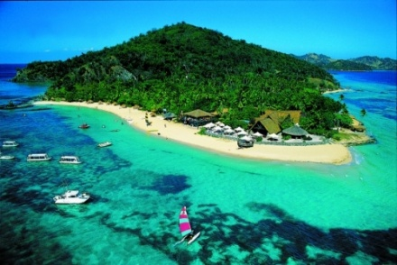
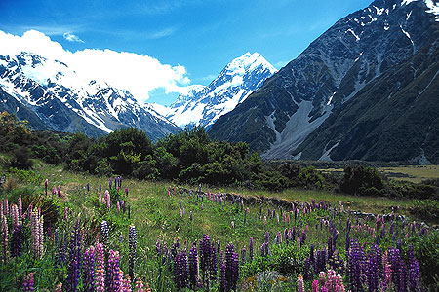
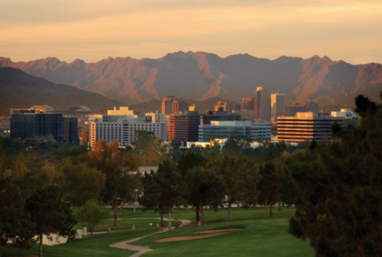
Comparisons of the Four Sites
Bolivia
Fiji
New Zealand
Southwest U.S.

Slide 9
Fairness in Phoenix, United States
http://www.flickr.com/photos/mandj98/3075340790/
Notes:
Theme: Water cost
Detailed Description: This meta-theme covers descriptions relating to the cost of water.
Inclusion Criteria: Statements that discuss how much (or little) water costs, the need to pay for water, or a lack of a need to pay for water.
Exclusion Criteria: Statements that do not directly allude to some sort of monetary or goods transfer in relation to water. Descriptions of water rights, water sources, or water quality should not be coded as relating to “water cost.”
Typical Exemplars: water requires payment; comparatively inexpensive water
Atypical Exemplars: rural areas do not require payment; pay for the water of others; has water meter
Close but no: public water source

Slide 10
Comparisons of the Four Sites
Bolivia
Fiji
New Zealand
Southwest U.S.

Slide 11
Comparisons of the Four Sites
Bolivia
Fiji
New Zealand
Southwest U.S.

Slide 12
Comparisons of the Four Sites
Bolivia
Fiji
New Zealand
Southwest U.S.

Slide 13
Explanatory Model: Equality and Equity
Water
Cost
Should people be punished for using more than their fair share of water?
Should people have the right to sell and lease their water rights to others?
Should water be distributed free to everyone?
Is it fair for there to be low water pressure?
Are too few rights allocated to indigenous people?
Fair Water Management
Vulnerable
By the Institution
Water Quality

